Slide 1
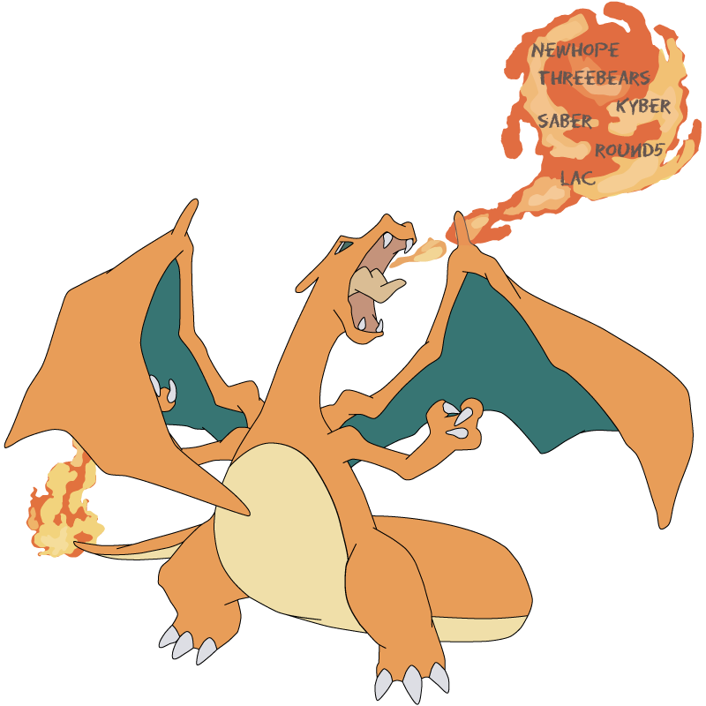
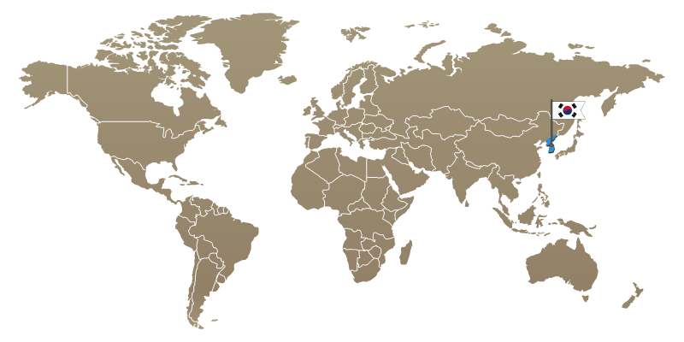
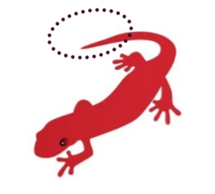
LizarMong: Excellent KEM based on RLWE and RLWR
Chi-Gon Jung¹, JongHyeok Lee², Youngjin Ju³, Yong-Been Kwon⁴, Seong-Woo Kim¹, and Yunheung Peak¹
¹ Seoul National University, ² Kookmin University, ³ Hanyang University, ⁴ Hansung University
<image source: https://csrc.nist.gov/CSRC/media/Presentations/Lizard/images-media/Lizard-April2018.pdf >
Notes:
Good afternoon.
Thank you for being here.
The topic of my presentation today
is an excellent key encapsulation algorithm based on Ring-LWE and Ring-LWR.
Our scheme name LizarMong is inspired by the character of the Japanese anime Pokémon.
Lizard, one of the Pokémon characters, evolves into LizarMong when he gains experience.
Our scheme has been improved to reflect the latest studies based on Ring-Lizard by Cheon.

Slide 2
Contents
Introduction
Detail to LizarMong
Specifications
Security Analysis
Correctness Analysis
Resistance to known side-channel attacks
Evaluation
Conclusion
Q&A
Notes:
I will divide my presentation into Introduction, detail to LizarMong, conclusion, and Q&A.

Slide 3
Introduction

Slide 4
NIST Post-Quantum Cryptography Competition
Goal
to develop cryptographic systems (signature, encryption, and key-establishment)
that are secure against both quantum and classical computers,
and can interoperate with existing communications protocols and networks.
Progress (2016 ~ ): 2017 - 1st Round Begins / 2019 - 2nd Round Begins
Evaluation Criteria
Security: focus on categories 1, 2, and 3. (i.e. 128-192bit security strength.)
Cost and Performance
The size of public keys and ciphertext. (In this work called bandwidth)
Computation efficiency of key generation, public and private key operations. (called performance)
Probability of decryption failures. (called correctness)
Notes:
As many people know,
NIST post-quantum cryptography competition's goals
to develop cryptographic systems
that are secure against both quantum and classical computers
and that can interoperate with existing protocols and networks.
The scope of NIST's competition
is signature, encryption, and key establishment schemes.
Our work focuses on key establishment schemes.
NIST's evaluation criteria are security, cost, and performance.
Among them, cost and performance are divided into several categories.
In this study,
the size of public-key and ciphertext is called bandwidth,
computation efficiency is called performance,
And probability of decryption failures is called correctness.

Slide 5
NIST Post-Quantum Cryptography Competition
Main families for which post-quantum primitives
Lattice
Code
Multivariate
Hash
Other
(Isogeny)
Structured
Unstructured
Structured
Unstructured
LWE families
Learning with Error (LWE) family
Ring-LWE
families
Ring-LWE
family
NTRU
families
NTRU
In this work focused on Ring-LWE family.
Simple, efficient, and parallelizable.
Provably secure under a worst-case.
Relatively well-study.
Notes:
Also, in this work considered Ring-LWE family such that Ring-LWR, Module-LWE and Module-LWR.

Slide 6
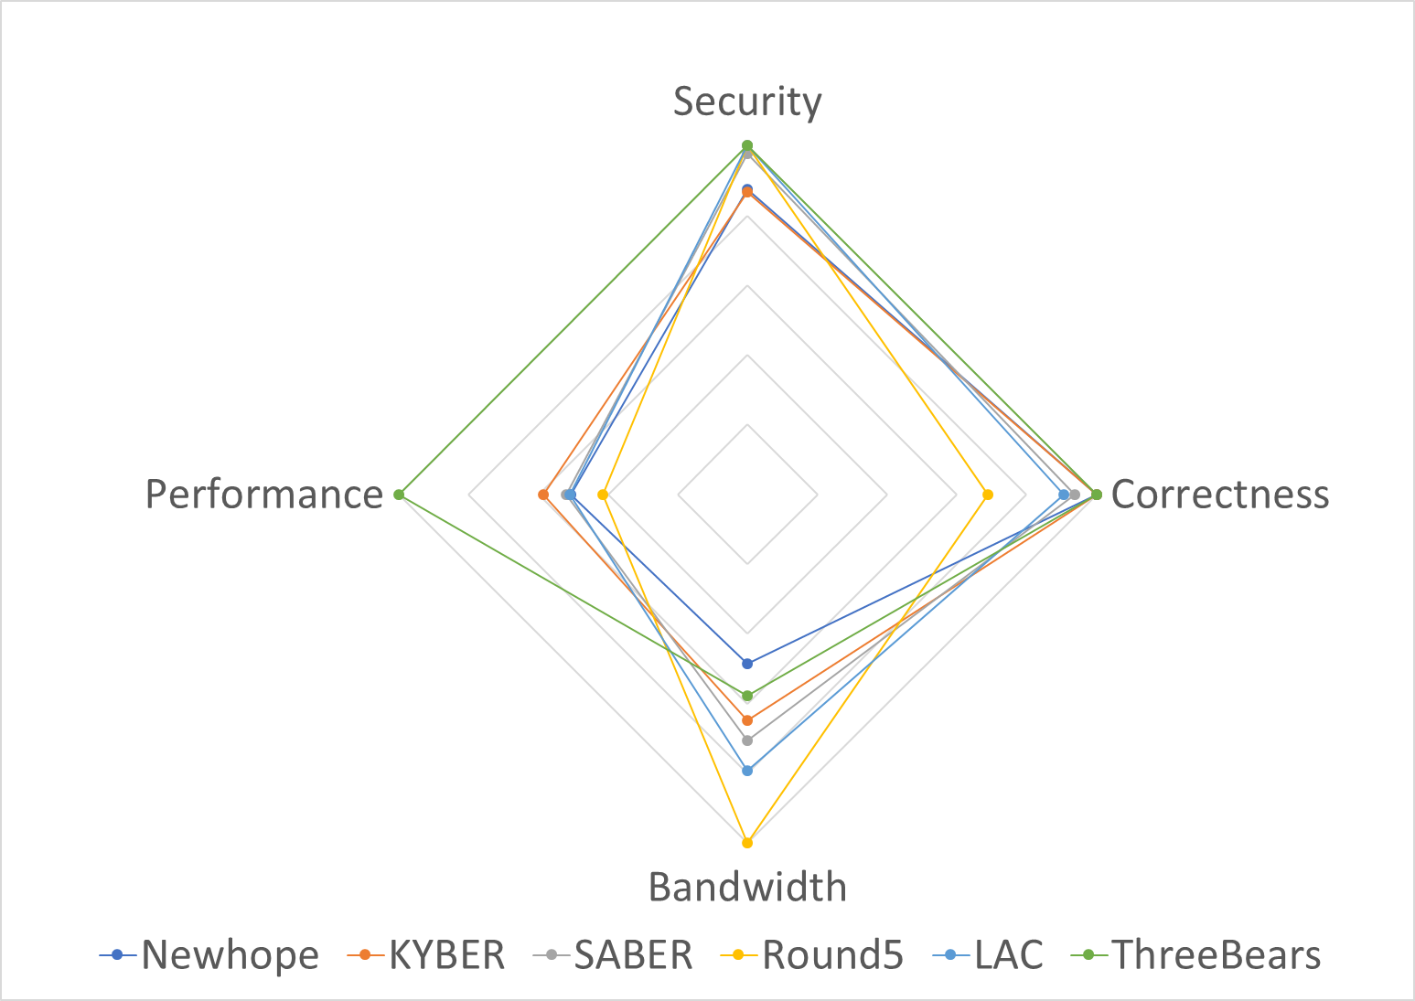
Which is the best among NIST candidate algorithms?
< Evaluating of 128-bit security-level KEM >
All evaluation criteria are important.
NIST said “Still open to mergers.”
Most of latest studies are not included.
Side-channel attacks.
Errors in each bit occur dependently.
More efficient QROM for IND-CCA2.
★Goal: Making an excellent key encapsulation mechanism of all aspects ★
Notes:
This figure compares 128-bit security-level algorithms for each evaluation criterion.
Security gave a perfect score if it crossed a 2 to the 128, and Correctness gave a perfect score if it was less than a 2 to the -128.
Performance and bandwidth were evaluated relative to the best algorithm.
The candidate algorithms for the second round of NIST competition has brilliant techniques.
Unfortunately, however, choosing one excellent algorithm in all aspects is a hard decision.
In conclusion, we can’t answer this question.
“Which is the best??”
Thus, we try to make an excellent key encapsulation mechanism of all aspects.

Slide 7
Detail to LizarMong

Slide 8
Overview
Based on popular exist algorithm
Combines the merit of NIST candidate algorithms
Include state-of-the-arts studies
Based on RLizard^{[CKLS18]} (was 1st round candidate).
RLWE + RLWR and Sparse ternary secret.
Good performance, security, and correctness.
But, relatively large bandwidth.
Combines
Bytes Modulus^{[LAC]}, Error correction code^{[Round5]}, and Centered binomial distribution^{[NewHope]}.
Public-key and ciphertext compress technique.
Includes
Countermeasures against known side-channel attacks.
Error dependency^{[DVV19]}.
Improved QROM for IND-CCA2^{[JZC+18]}.
LizarMong
Notes:
Our main idea for making excellent KEMs in all aspects is three.
First, it is based on well-study and famous algorithm.
Second, it combines the merit of the NIST candidate algorithms.
Third, Include state-of-the-arts studies.
Followed this idea,
First, LizarMong based on Ring-Lizard by cheon
Second, it combines LAC's byte-size modulus, Round5's error correction code called XE5, and NewHope's central binomial distribution.
Also, it Includes Countermeasures against known side-channel attacks, Error dependency by DVV19, and Jiang’s IND-CCA2 transformation technique.

Slide 9

Specification of LizarMong
Design elements
Reduce the bandwidth and maintain the RLizard’s strengths.
Minimized known side-channel attack points.
Compare | Underlying Problem | Ring | Compress | Modulus | ECC | Distributions
 |  |  |  |  |  | Secret | Error
LizarMong | RLWE+RLWR |  | Yes | Small (fixed 2⁸) | XE5 | Uniform sparse ternary | Binomial (std≈0.7)
RLizard | 〃 | 〃 | No | Small (2^{10~12}) | None | 〃 | Gaussian (std≈1.15)
$$ℤ_{q}/X^{n}+1$$
Why? | Key: conservative Enc/Dec: Fast | Fast / secure | Bandwidth | Bandwidth, Performance | Correctness, Side-channel | Correctness, Performance | Side-channel Correctness, Performance
Proved | - | - | Common in NIST’s Alg. | [PRSD17] | [Saa17] | - | [ADPS16]
Notes:
This table summarizes LizarMong's design elements.
The focus of selecting design elements is to reduce bandwidth and minimize side-channel attack points.
Underlying problem, ring, and secret distribution are the same as Ring-Lizard.
On the other hand,
LizarMong uses ciphertext and public key compression techniques.
This is a common technique used by all NIST candidate algorithms.
In short, public-key compression sends only seed instead of a randomly sampled from Rq, and ciphertext compression discards the lower few bits of c2.
We select q is 2 to the 8. which is small and to the power of two.
Intuitively, this choice enjoys a small bandwidth and improved performance. It also provides very efficient modulo operation and memory usage and is suitable for single instruction multiple data (SIMD) implementations such as AVX2 and NEON. Even though the modulus is small, it can not affect the security since we maintain the error rate by selecting proper error distribution.
Small 'q' decreases the correctness because it increases the error-rate.
Therefore, our scheme is needed an error correction code.
powerful error correction codes such as BCH can be used, but it is not adopted due to performance overhead and side-channel attack issues.
We adopted XE5, that is specialized in the RLWE.
The XE5 has a 5-bit error correction capability and is a very simple linear code with very little performance overhead and resist timing attacks.
Most of NIST’s candidate algorithms use the same distribution for error and secret sampling. Recently, however, a fault-attack attempted to analyze by manipulating the Seed to make s and e the same value. Therefore, we sample e and s from each distribution to remove the fault-attack point.
We use Newhope's central binomial distribution instead of the CDT sampling method used by RLizard.
Because CDT is too exposed to side-channel attacks such as timing and cache attacks.
Although the original RLWE is defined as a Gaussian distribution, switching to the centered binomial distribution is known to have a negligible impact on security. Also, the best-known attacks against RLWE depend not on the type of the distribution but the standard deviation.

Slide 10
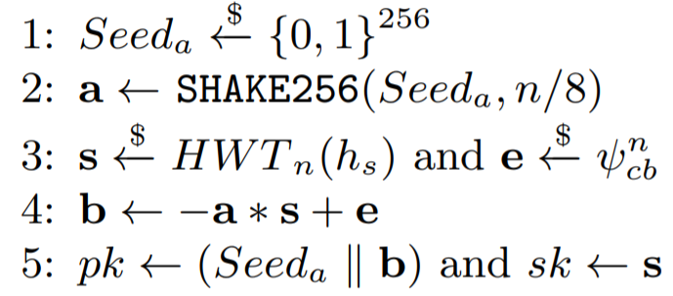
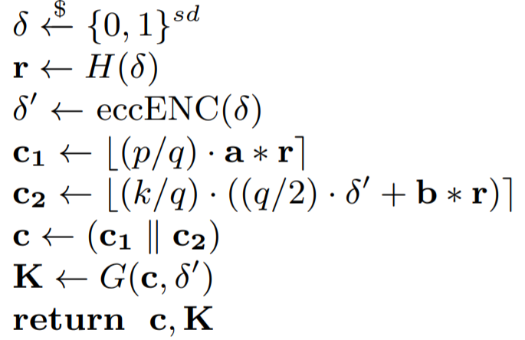


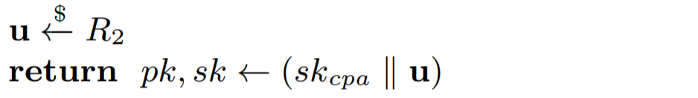
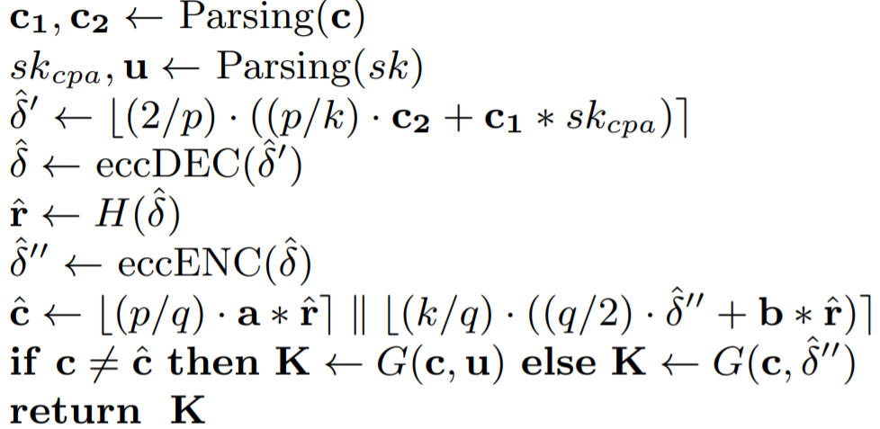
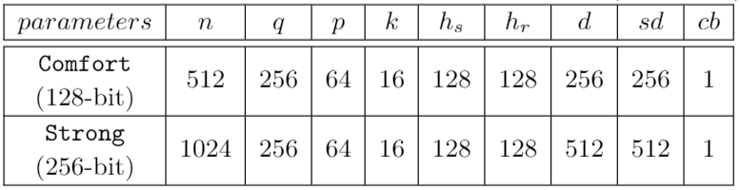
Specification of LizarMong
IND-CCA2 KEM
Bob (Server)
Alice
(Client)
① Key generate
② Encapsulation
Public-key (pk)
544byte (in Comfort) or
1056byte (in Strong)
2^7
1
Ciphertext (c)
640byte (in Comfort) or
1280byte (in Strong)
1
③ Decapsulation
2^(-4)
1
< Detail parameters for each security-level >
11-6
Notes:
We construct a Comfort version that satisfies category1 security level (128-bit) and a Strong version that satisfies category5 security level (256-bit) as required by the NIST standardization process.
Table shows the detailed parameters of each security level.
We design IND-CCA KEM using the transformation technique by Jiang.
It does not need Targhi and Unruh’s additional hash.
Thus, it transformations without any ciphertext overhead.
As a result, the bandwidth in the Comfort parameter is only 1184 bytes and the Strong parameter is 2336 bytes. It is the lowest bandwidth among the NIST candidates.

Slide 11
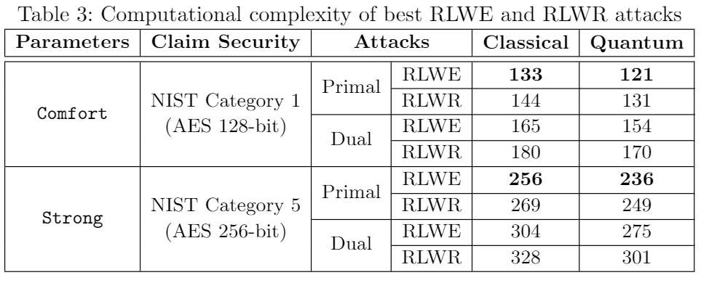
Security analysis
Security Proof
Cryptanalytic attacks
BKZ lattice basis reduction algorithm.
The core SVP. (ignores repeated calls for SVP oracle)
Use ‘online LWE estimator’ ^{[Alb17].}
Consider Dual and Primal attack like RLizard.
RLWE / RLWR
Lemma 1.
RLizard (IND-CPA PKE)
Theorem 1.
Under the assumption that SHAKE256 is ROM
LizarMong
(IND-CPA PKE)
Jiang’s Transformation
LizarMong
(IND-CCA2 KEM)
Notes:
Security proof is proved by Rlizard, SHAKE256, and Jiang’s QROM.
Our security analysis is based on the pessimistic approach of the BKZ lattice basis reduction algorithm [5]. Also, we use the attack complexity calculation and the online LWE estimator by Albrecht et al. [3,4]. Those are common methods used by most RLWE family algorithms. The BKZ algorithm proceeds by reducing a lattice basis using the SVP oracle repeatedly. There are several discussions about measuring the number of iterations. The core SVP method ignores repeated calls for SVP oracle, which is a pessimistic estimation from the defender point of view.
As a result, the comfort parameter has a computational complexity of 2 to the 133 and strong has a computational complexity of 2 to the 256.

Slide 12




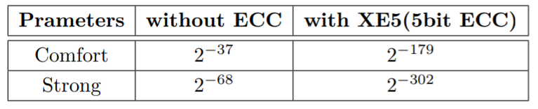
Correctness analysis
Estimating the Correctness considering the dependency of each bit error.
The correctness of all RLWE estimates on the assumption that errors occur independently.
The independent assumption was disproved ^{[DVV19]}; Especially improper using ECC.
Decryption failure is when satisfied $\left|e∗r+s∗f+g\right|≥\frac{q}{4}−\frac{q}{2p}.$
$f=a∗r−\left(q/p\right)c_{1};g=v−\hat{v};v= , \hat{v}=v≪(\log{p}−\log{k)}$
$\operatorname{Pr}\left[Fail\right]≈\sum_{∥S∥,∥C∥}{\left(1−Binom\left(d, l_{m},p_{b}\right)\right)∙\operatorname{Pr}\left[\left\|S\right\|\right]∙\operatorname{Pr}\left[\left\|C\right\|\right]}$
, , , $l_{m}=512, d=5$
Notes:
D0Anvers et al. proved [16] theoretically and experimentally that the error between each bit does not occur independently.
even if the probability of error occurrence between each bit is not independent, the calculation based on the independence assumption is valid when the error correction code is not used. However, It is inappropriate when the error correction code is used.
Since LizarMong uses the error correction code, we calculate the probability of failure under the assumption that the error of each bit occurs dependently.
G is compression error.
Binom(d, lm, pb) is 메시지 길이가 l이고 오류정정능력이 d이고, 에러발생확률이 pb일때 복호화 성공확률.
에러의 종속성은 s와 c에 의존한다는 가정임.
According to our calculation, the decryption failure probability of LizarMong is negligible.

Slide 13
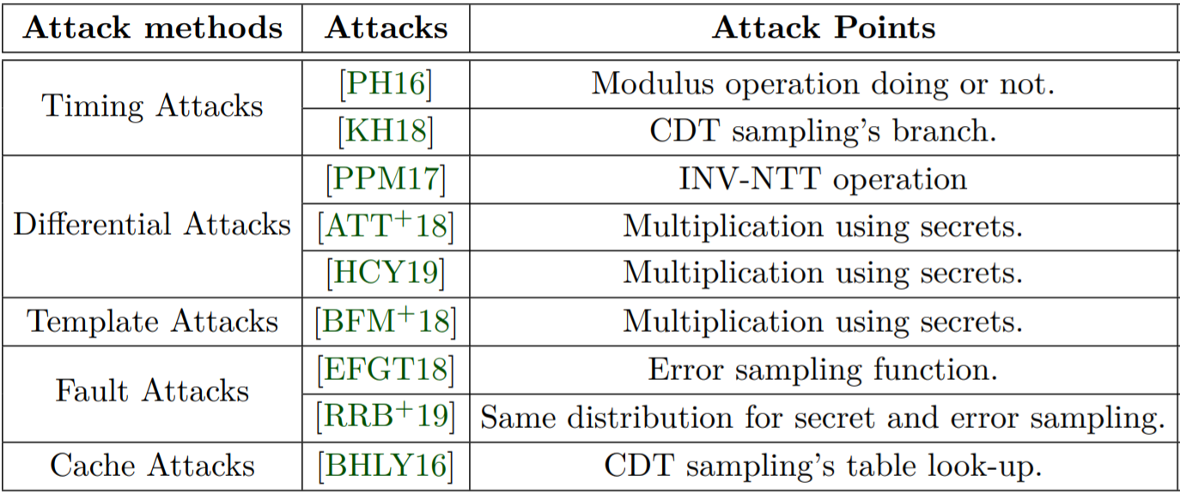
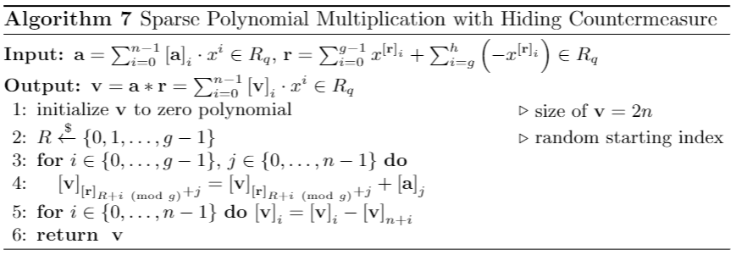
Resistance to known side-channel attacks
We investigated the known major side-channel attacks and the points they exploited.
Our strategy
First, ruled out the targeted by the known attacks during the design element selection.
Second, internalizes efficient countermeasures for unavoidable vulnerabilities.
AND and ADD instead of Modulus Op.
Do not use NTT
Devised sparse polynomial multiplication with Hiding
Check the final loop index
Each distribution for error and secret
Replaced with centered binomial distribution
Notes:
We investigated the known major side-channel attacks and the points they exploited.
The strategy for making LizarMong resistant to known side-channel attacks is as follows.
First, we ruled out the operations targeted by the known attacks at the design element selection stage.
Second, for unavoidable vulnerabilities, we added a strategy that internalizes efficient countermeasures
According to the first strategy, LizarMong resists known cache and timing attacks, as well as some differential and fault attacks.
Despite efforts to minimize attack points at the design element selection stage, some differential attacks and fault attacks are still applicable.
So, we devised sparse polynomial multiplication with Hiding and checked the final loop index.

Slide 14
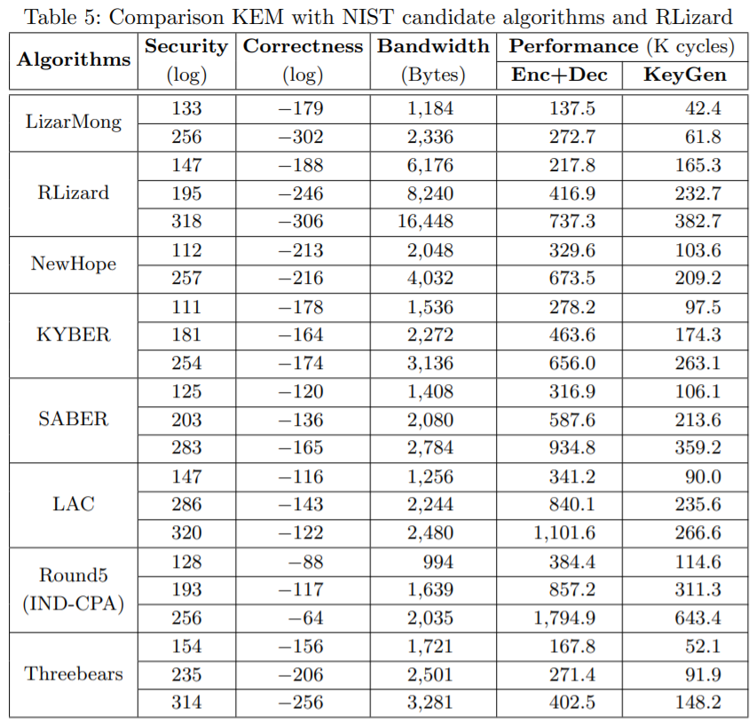
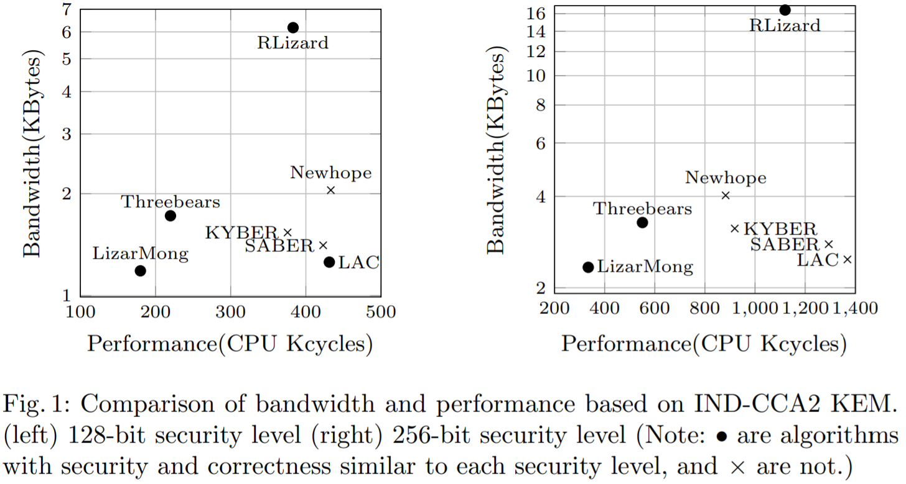
Evaluation
Compare with RLizard,
Band.: up to 85% smaller / Perfor.: 3.3x faster
Compare with NIST candidate Algorithms,
Band.: 5~42% smaller / Perfor.: 1.2~4.1x faster
11-10
Notes:
Our comparison is based on the NIST official documents and optimized code.
The result of evaluation is shown in Table 5 and Fig. 1. In Table 5, the three rows for each algorithm correspond to 128, 192, and 256-bit security levels.
the evaluation environment is Intel i7-9700K@3.2GHz CPU, ubuntu 16.04.11, GCC 5.4.0 with option −O3, and the value is the average for 1000 iterations.
The security of some algorithms seems to be slightly lacking to each security level (see Table 5). However, LizarMong.Comfort reaches 128-bit security level and LizarMong.Strong reaches 256-bit security level.
Unfortunately, our scheme does not support the 192-bit security level, but Strong has a competitive bandwidth and performance compared with the 192-bit security level of other algorithms. Therefore, Strong can sufficiently replace the 192-bit security level of other algorithms.
KYBER, SABER, LAC, and Round5 have smaller failure probability of decryption compared to the mapped security level. However, LizarMong has negligible failure probability. Also, our estimation is accurate than others because we consider dependency.
Also, compared with NIST’s candidate algorithms, the bandwidth is about 5-42% smaller, and the performance is about 1.2-4.1 times faster. Also, it resists known side-channel attacks.
Also, it resists known side-channel attacks.

Slide 15
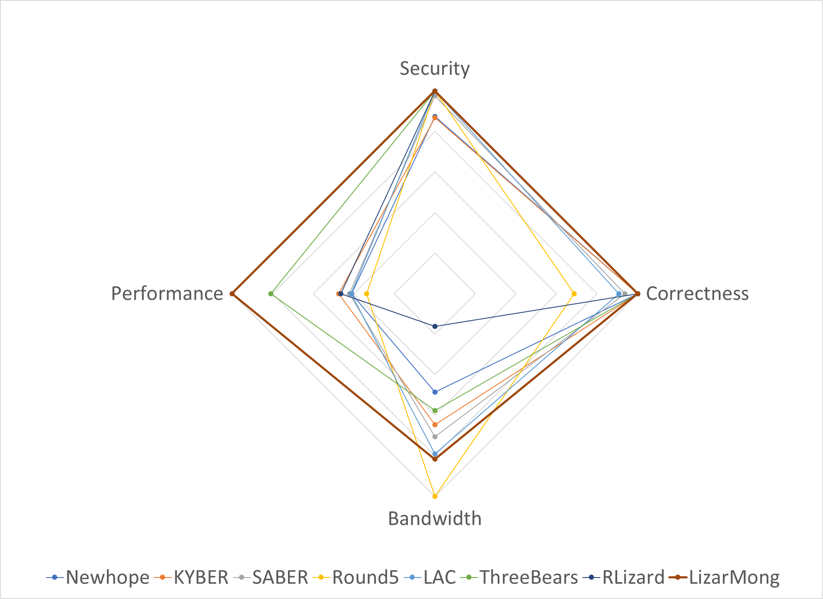
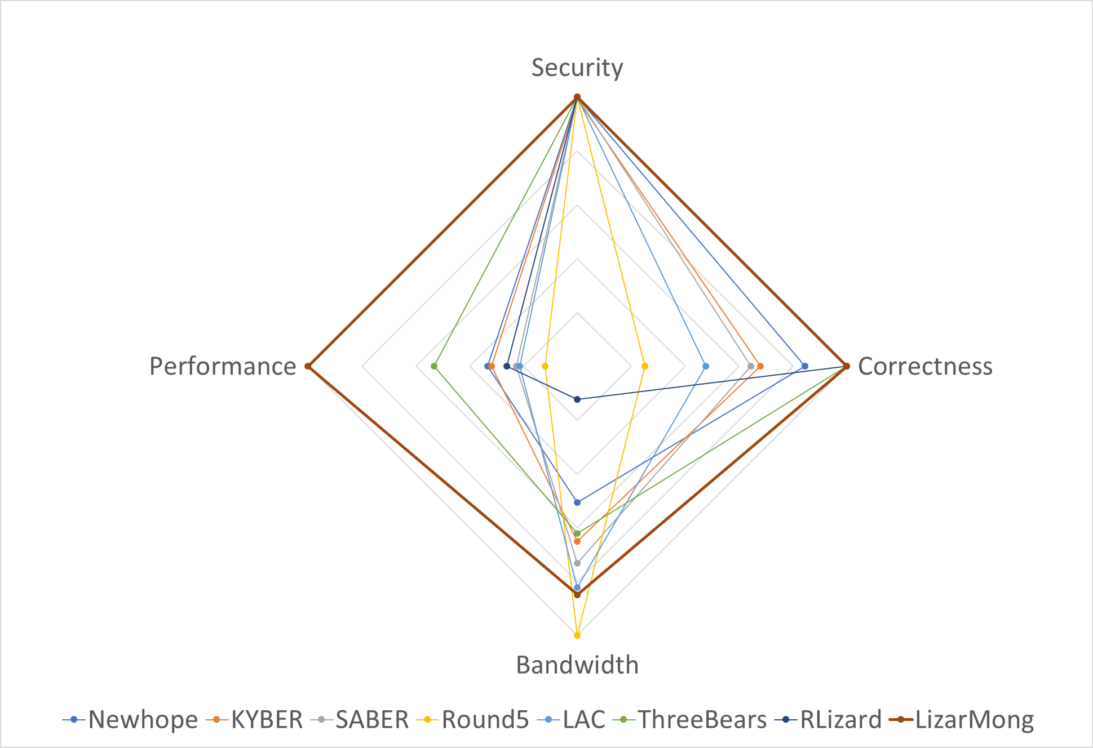
Conclusion
< 128bit security >
< 256bit security >
★ LizarMong is excellent key encapsulation mechanism of all aspect! ★
11-11
Notes:
Our scheme, called LizarMong, is the best of the RLWE family of key encapsulation algorithms to date.

Slide 16



Have any Questions? Thank you!
<fig. refer: https://csrc.nist.gov/CSRC/media/Presentations/Lizard/images-media/Lizard-April2018.pdf >
Notes:
Thank you. If there are any questions, I shall do my best to answer them.

Slide 17
References
[ATT+18] Aydin Aysu, Youssef Tobah, Mohit Tiwari, Andreas Gerstlauer, and Michael Orshansky. Horizontal side-channel vulnerabilities of post-quantum key
exchange protocols. In 2018 IEEE International Symposium on Hardware Oriented Security and Trust (HOST), pages 81–88. IEEE, 2018.
[ADPS16] Erdem Alkim, Léo Ducas, Thomas Pöppelmann, and Peter Schwabe. Post-quantum key exchange a new hope. In 25th {USENIX} Security
Symposium ({USENIX} Security 16), pages 327–343, 2016.
[Alb17] MR Albrecht. A sage module for estimating the concrete security of learning with errors instances (2017).
[BFM+18] Joppe W Bos, Simon Friedberger, Marco Martinoli, Elisabeth Oswald, and Martijn Stam. Assessing the feasibility of single trace power analysis of
frodo. In International Conference on Selected Areas in Cryptography, pages 216–234. Springer, 2018.
[BHLY16] Leon Groot Bruinderink, Andreas Hülsing, Tanja Lange, and Yuval Yarom. Flush, gauss, and reload–a cache attack on the bliss lattice-based
signature scheme. In International Conference on Cryptographic Hardware and Embedded Systems, pages 323–345. Springer, 2016.
[CKLS18] Jung Hee Cheon, Duhyeong Kim, Joohee Lee, and Yongsoo Song. Lizard:Cut off the tail! a practical post-quantum public-key encryption from lwe
and lwr. In International Conference on Security and Cryptography for Networks,pages 160–177. Springer, 2018.
[DVV19] Jan-Pieter D’Anvers, Frederik Vercauteren, and Ingrid Verbauwhede. The impact of error dependencies on ring/mod-lwe/lwr based schemes.
In International Conference on Post-Quantum Cryptography, pages 103–115. Springer, 2019.
[EFGT18] Thomas Espitau, Pierre-Alain Fouque, Benoit Gerard, and Mehdi Tibouchi. Loop-abort faults on lattice-based signature schemes and key exchange
protocols. IEEE Transactions on Computers, 67(11):1535–1549, 2018.
[HCY19] Wei-Lun Huang, Jiun-Peng Chen, and Bo-Yin Yang. Correlation power analysis on ntru prime and related countermeasures. IACR Cryptology ePrint
Archive, 2019:100, 2019.

Slide 18
References
[KH18] Suhri Kim and Seokhie Hong. Single trace analysis on constant time cdt sampler and its countermeasure. Applied Sciences, 8(10):1809, 2018
[Mos18] Michele Mosca. Cybersecurity in an era with quantum computers: will we beready?IEEE Security & Privacy, 16(5):38–41, 2018
[PH16] Aesun Park and Dong-Guk Han. Chosen ciphertext simple power analysis on software 8-bit implementation of ring-lwe encryption. In 2016 IEEE
Asian Hardware-Oriented Security and Trust (AsianHOST), pages 1–6. IEEE, 2016.
[PPM17] Robert Primas, Peter Pessl, and Stefan Mangard. Single-trace side-channel attacks on masked lattice-based encryption. In International Conference
on Cryptographic Hardware and Embedded Systems, pages 513–533. Springer, 2017.
[PRSD17] Peikert, C., Regev, O., Stephens-Davidowitz, N.: Pseudorandomness of ring-lwe for any ring and modulus. In: Proceedings of the 49th Annual ACM
SIGACT Symposium on Theory of Computing. pp.461–473. ACM (2017)
[RRB+19] Prasanna Ravi, Debapriya Basu Roy, Shivam Bhasin, Anupam Chattopadhyay, and Debdeep Mukhopadhyay. Number “not used” once-practical
fault attack on pqm4 implementations of nist candidates. In International Workshop on Constructive Side-Channel Analysis and Secure Design,
pages 232–250. Springer, 2019.
[Saa17] Markku-Juhani O. Saarinen. Hila5: On reliability, reconciliation, and error correction for ring-lwe encryption. Cryptology ePrint Archive, Report
2017/424, 2017. https://eprint.iacr.org/2017/424.
[HHK17] Dennis Hofheinz, Kathrin Hövelmanns, and Eike Kiltz. A modular analysis of the fujisaki-okamoto transformation. In Theory of Cryptography
Conference, pages 341–371. Springer, 2017.
[JZC+18] Haodong Jiang, Zhenfeng Zhang, Long Chen, Hong Wang, and Zhi Ma.Ind-cca-secure key encapsulation mechanism in the quantum random oracle
model, revisited. InAnnual International Cryptology Conference, pages 96–125.Springer, 2018.

Slide 19

Compress techniques
All NIST candidate algorithms commonly use compression techniques.
Public-key: Sending only the gen_a_seed instead of $a∈R_{q}$, and recovers using a hash.
* pk size: $2n\log{q} →\left|gen_a_seed\right|+n\log{q}$.
Ciphertext: Discarding a few bits of LSB in $c_{2}$.
* ctx size: $2n\log{p} →n\log{p}+n\log{k}, where k<p is compress modulus$
How does compress affect the scheme?
How is the size of gen_a_seed?
NIST candidate algorithms use 128 or 256bit. we choose 256bit from a conservative.
Ciphertext compress reduce the correctness?
Yes! However, we already include it in calculation of the failure rate.

Slide 20
Small modulus fixed at 2⁸
Reduce bandwidth: to make lattice dimension $n$and RLWE modulus $q$ small.
Since the ring , the smaller $n$ is 256; however, difficult to satisfy security.
Therefore our choice is only to make $q$ smaller.
How does small $q$ affect the scheme?
$$ℤ_{q}/X^{n}+1$$
Harmful to RLWE hardness?
No! Maintain the error-rate by selecting proper error distribution^{[PRSD17]}.
LAC also use $q$=251.
Reduce the Correctness?
Yes! Because decryption fails when $\left|error≥q/4−q/{2p}\right|$.
LizarMong adopts error-correcting code (ECC) to solve this problem.

Slide 21
Error-correcting code, XE5
4-5 bit error correction capability is required.
Adopted XE5^{[Round5]} that is specialized in the RLWE.
256bit message $p$, 234bit parity check $r$, codeword $c=p||r$, correction capability is 5bit.
How does XE5 affect the scheme?
Performance overhead? Yes! But, it is very small (only 600 cycles).
Side-channel attacks?
No! XE5 resist timing attack as avoid table look-up and branch^{[Round5]}.
The impact of error dependencies?
Yes! The calculation is inappropriate when the error-correcting code is used^{[DVV19]}.
To solve, calculate the failure rate under the assumption that error occurs dependently.

Slide 22
Resistance known side-channel attacks (1/2)
According to the 1st strategy, avoiding against known cache and timing attacks, and some differential and fault attacks.
Modular operation: choice all modulus are power-of-two. So, AND and ADD instead of it.
CDT branch and table look-up: CDT was replaced with centered binomial distribution.
Same distribution for error and secret: designed to sample within each distribution.
INV-NTT: do not use NTT.
How does this design choice affect the scheme?
Centered binomial distribution ?
Most of NIST candidates used it. The attacks against RLWE depend on only the stddev.
Each distribution for error and secret?
Original RLWE defines each distribution for error and secret.

Slide 23
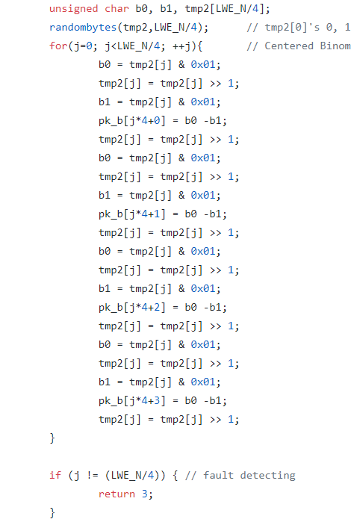
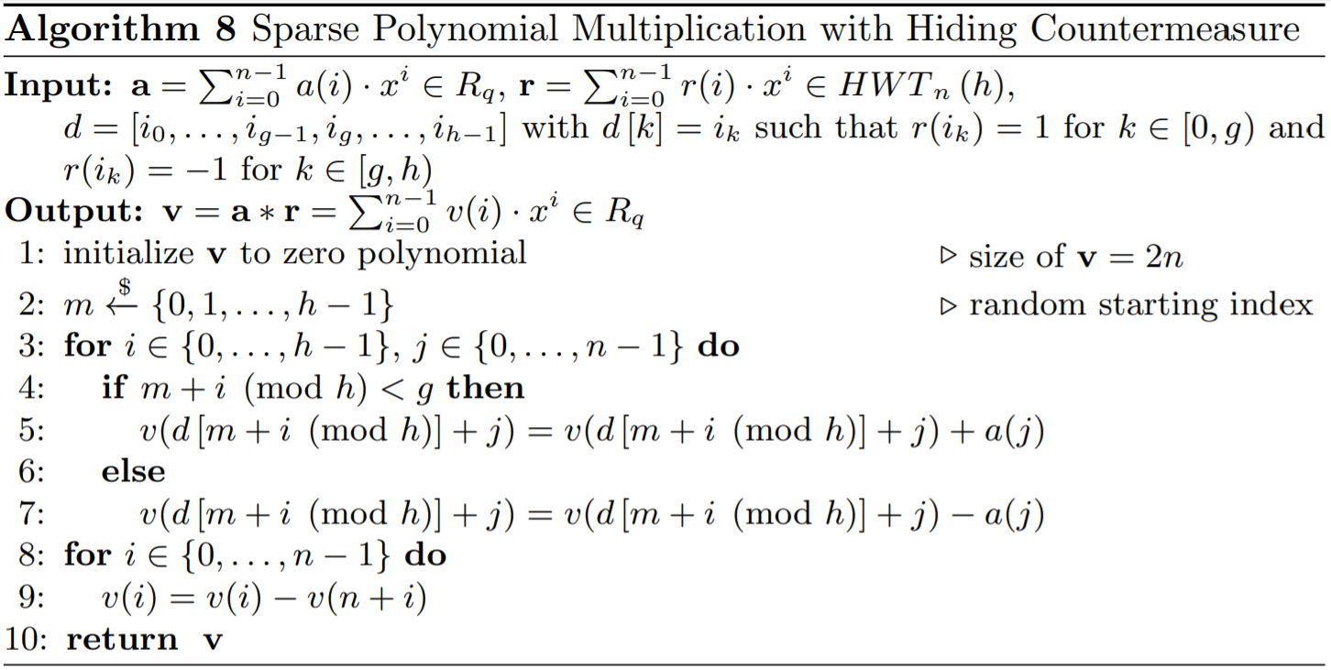
Resistance known side-channel attacks (2/2)
According to the 2nd strategy, added countermeasures against the remaining attacks.

